Slide 1
Draping
Lesson 1 – The Dressform

Slide 2
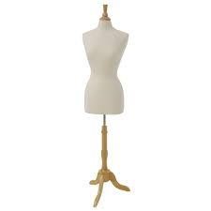
What is a dressform?
This is a dressform -----------------------------→
It’s a soft mannequin torso, used for pinning
up fabric to making a garment

Slide 3
Dressform sizes
Dress forms some in all kinds of different size
However past a XL they can be near impossible to find
Cursed Fashion Industry Beauty Standards

Slide 4
Adjustable dressforms
Adjustable dressforms can obviously adjust to different measurements in different areas of the body
If you make customizable clothing or a large size range, these are best for you.

Slide 5
Dressform padding
Dressform padding can be attached to a dress form to add extra to the shoulder, bust, hips, and stomach

Slide 6
Video Time!
https://www.youtube.com/watch?v=mU0bl03OK0c

Slide 7
Practice! Assignment 4-1
Pick a dressform from class
You’ll be setting these up to your, or a model of your choice’s, measurements
See Assignment 4-1 paper for more details

